Slide 1
GEHC SDT Weekly Status Report
04/26/17

Slide 2
Open Actions
Action item | Owner | Forum | Expected Closure Date | Actual Closure Date | Owner Comment | Status
Mobility Team or tiger team to be formed to resolve all CLICK mobile issues. | Rohit/Gopi | Jan’ 17 Workout | TBD | 25-Apr-2017 | On monitoring the debug logs: No Issues reported hence closing the item | Closed
Performance issues: SDT Booking and Architecture Assessment. | Hita/Andrey/Urmila/Chandra | Jan’ 17 Workout | 28-Feb-2017 |  | Demo completed on Logging tool and Performance assessment user stories with PO. | In Progress
Ownership on Tickets/Process adherence(Agile Mechanism) | Suvarna/Sathyaraj | Jan’ 17 Workout | Ongoing |  |  | In Progress
GEHC to check and confirm on L1 support - on call support | Chandra/CG | Jan’ 17 Workout | TBD |  | No services available in ServiceNow tool. Exploring other opportunities | In Progress

Slide 3
Weekly Snapshot – 04/26/17
Health of the Engagement
Highlights
Successful CLICK R2.3 deployment on production for EU and APAC/KOREA
Weekly Master data uploaded successfully
Development of all performance related user stories marked for this current sprint are demoed to the product owners.
As per our recent CAST run the current Technical quality index(2.75) has increased by 6.74% as compare to earlier TQI(2.63) .
Grades for Programming Practices has increased by 6.39%.
GREEN
Risk / Issues / Challenges
Help Needed
Issues in comprehending data flow due to unavailability of CLICK environment details - Rohit
Unavailability of MT analyzer tool access will lead to difficulties in viewing of messages (Request & Response) for all the CLICK environment – Chandra
Issues in the CRP environment may impact current sprint user stories testing process – Chandra
Rolling back of CLICK changes implemented in production will lead to productive loss of resources - GE
Need clarity on the responses received related to webservers, latency, timing, frequency of patches and domain policies on server infrastructure related queries - Chandra

Slide 4
Focus Area Updates
Focus Areas | Owner | Status | Comments
Mobile Sync Issues | CG Team | Closed | Yet to receive end to end environments details from CLICK team denied due to policy reasons Connected with business user for issues reported in debug log) :No issues reported till now.
SDT Booking Performance Issues | CG Team | In Progress | Demonstrated 10 user stories to Product owner and received go ahead for production from Product owner on demonstrated user stories.
Release Management | CG Team | Ongoing | Release check list was created and it is updated in our Release readiness check call.
Incident Management | CG Team | Ongoing | Streamlining incidents w.r.t CLICK support cases Problem ticket creation process finalized. Incidents reported in this week are closed.
Support and Development Process streamlining | CG Team | Ongoing | Agile metrics identified and tracked through Rally. Ensuring all email communication to have incident ticket created. Internal defect tracker is maintained to track the QA/UAT defects and owners defined for each defect.

Slide 5
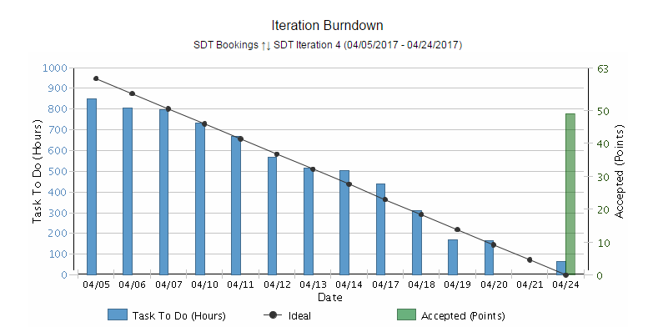
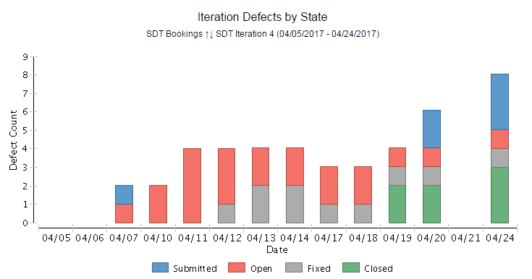
Weekly Snapshot & Agile Metrics – SDT Development
Release 2
Iteration 4 Burndown chart
Health of the Egagement
SDT Iteration 3 -(03/21/2017 -03/31/2017) -Completed
SDT Iteration 4 -(04/05/2017 -04/19/2017 –Completed
Iteration review: 04/24/2017
Backlog Grooming: 04/26/2017
Iteration retrospectives: 04/26/2017
Release 2 –Iteration 4 highlights
Committed User Stories for Iteration 4 :12
Testing could not complete before 04/19/2017 due to Click login issue.
Testing –Completed user stories in local environment as CRP is down.
Demonstrated 10 user stories to Product owner and received acceptance from Product owner on demonstrated user stories.
Received feedback/suggestions on the demonstrated user stories and added that as an backlog item in Rally.
CRP testing is pending due to the CRP environment issue.
Defects are tracking through rally.
Iteration 4 Defect by State
Risk / Issues / Challenges
Help Needed

Slide 6
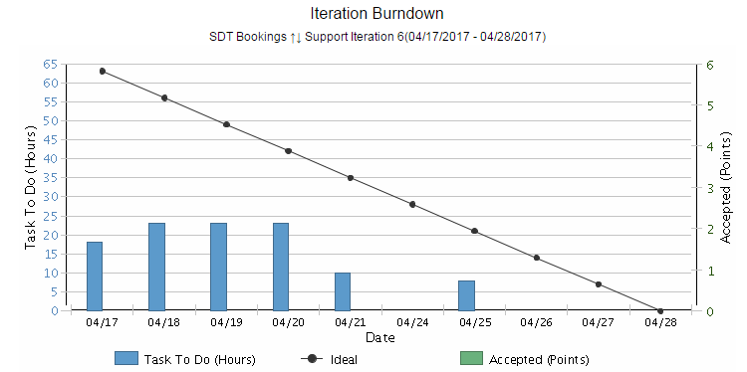
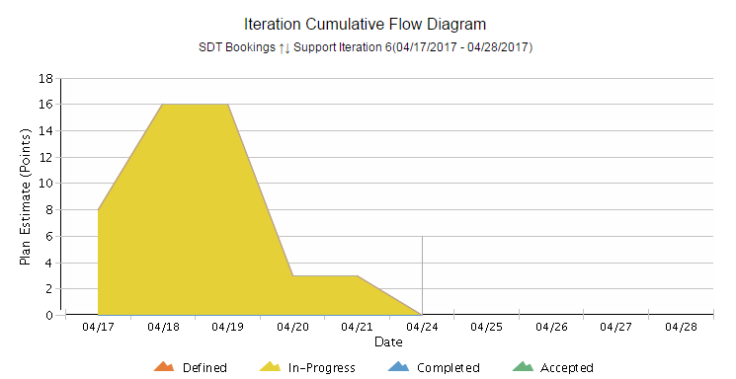
Agile Metrics - Support
Support Iteration 6 (04/17/2017 - 04/28/2017)
Burndown chart
Inferences
Iteration Support Burndown Chart:
Support activities keep on added up on a daily basis based on the support tickets that we receive. Hence there’s a mismatch with ideal.
End of the sprint, all tickets are closed and all the user stories are accepted by Product owner.
Iteration Cumulative Flow Diagram
The tasks related to R2.3 Deployment on Prod for EU and APAC/KOREA are completed successfully.
Weekly master data load has been completed.
5 incidents are in progress.
3 incidents for awaiting 3rd party approval are moved from Iteration 5 to 6 are completed.
Cumulative Flow Diagram

Slide 7

Agile Metrics – SDT Booking Velocity Chart
SDT
Inferences- Velocity Chart
SDT Iteration 1
Velocity of team:50 story points
Accepted By PO: 13 story Points
US85 and US 97 –Accepted by PO as these user stories are already deployed in production as part of release 1.3.1
Iteration length: 10 days(2 weeks)
SDT Iteration 2
Velocity of team: 9 story points
Accepted By PO: 9 story Points
Iteration length: 5 days(1 week)
SDT Iteration 3
Velocity of team: 20 story points
Accepted By PO: 17 story Points
Iteration length: 8 days
SDT Iteration 4
Velocity of team: 60 story points
Accepted By PO: 49 story Points
Iteration length: 14 days

Slide 8
Agile Metrics – Support Velocity Chart
Inferences-Velocity Chart
Support
Support Iteration 1
Velocity of team:5 story points
Accepted By PO: 5 story Points
Iteration length: 8 days
Support Iteration 2
Velocity of team:20 story points
Accepted By PO: 19 story Points
Iteration length: 12 days
Support Iteration 3
Velocity of team:20 story points
Accepted By PO: 20 story Points
Iteration length: 11 days
Support Iteration 4
Velocity of team:17 story points
Accepted By PO: 17 story Points
Iteration length: 11 days
Support Iteration 5
Velocity of team:20 story points
Accepted By PO: 12 story Points
Iteration length: 10 days

Slide 9
Agile Metrics – Resource Utilization
Weekly resource Utilization(24th Apr 2017 – 28th Apr 2017)

Slide 10
Incident Update
Resolved 1 incident ticket
15 Awaiting 3rd party - SDT Schedule / Mobile Issues
4 Awaiting User Info
Inferences

Slide 11
Incident Tickets
Incident Management
Incident # | Module | Key Words | Priority | Status | Location | Queue wait time
INC1735928 | SDT Schedule | Click Issue | 4 - Low | Awaiting 3rd Party | ASPAC-South Korea-Seoul | a month ago
INC1736222 | SDT Schedule | Click Issue | 4 - Low | Awaiting 3rd Party | ASPAC-India-Bangalore | a month ago
INC1738700 | SDT Module | Click Issue | 3 - Moderate | Awaiting 3rd Party | ASPAC-India-Bangalore | a month ago
INC1747182 | SDT Mobile | Click Issue | 3 - Moderate | Awaiting 3rd Party | ASPAC-India-Bangalore | a month ago
INC1754593 | SDT Module | Click Issue | 5 - Request for Service | Awaiting 3rd Party | ASPAC-India-Bangalore | a month ago
INC1766606 | SDT Module | Mobile Sync Issue | 3 - Moderate | Awaiting 3rd Party | ASPAC-India-Bangalore | a month ago
INC1777886 | SDT Module | Click Issue | 3 - Moderate | Awaiting 3rd Party | EMEA-Israel-Haifa | a month ago
INC1779626 | SDT Module | Click Issue | 3 - Moderate | Awaiting 3rd Party | ASPAC-Malaysia-Wilayah Persekutuan | a month ago
INC1793968 | Click | Click Issue | 5 - Request for Service | Awaiting 3rd Party | ASPAC-Malaysia-Wilayah Persekutuan | a month ago
INC1477114 | SDT Booking | Mobile Sync Issue | 4 - Low | Awaiting User Info | ASPAC-South Korea-Seoul | 2 months ago
INC1480772 | SDT Mobile | Mobile sync Issue | 4 - Low | Awaiting User Info | ASPAC-South Korea-Seoul | 2 months ago
INC1816304 | SDT Module | SDT Booking issue | 5 - Request for Service | Awaiting 3rd Party | EMEA-Israel-Haifa | 20 days ago
INC1825781 | Click | Click Issue | 4 - Low | Awaiting 3rd Party | ASPAC-South Korea-Seoul | 15 days ago
INC1831431 | Click | Click Issue | 1 - Critical | Awaiting 3rd Party | ASPAC-Malaysia-Wilayah Persekutuan | 13 days ago
INC1831436 | Click | Click Issue | 1 - Critical | Awaiting 3rd Party | ASPAC-Malaysia-Wilayah Persekutuan | 13 days ago
INC1840513 | Click | Click Issue | 2 - High | Awaiting 3rd Party | ASPAC-Malaysia-Wilayah Persekutuan | 8 days ago
INC1849680 | Click | Click Issue | 1 - Critical | Awaiting User Info | ASPAC-Malaysia-Wilayah Persekutuan | 4 days ago
INC1856211 | Click | Click Issue | 3 - Moderate | Awaiting 3rd Party | ASPAC-Malaysia-Wilayah Persekutuan | 2 days ago
INC1856638 | Click | Click Issue | 4 - Low | Awaiting 3rd Party | ASPAC-Malaysia-Wilayah Persekutuan | 2 days ago
INC1856850 | SDT Module | SDT Booking issue | 1 - Critical | Awaiting User Info | ASPAC-Philippines-Metropolitan Manila | 1 days ago
Problem Management
Problem # | Module | Keyword | Status |  |  | Incident #
PRB0045855 | SDT Booking | Google API | Closed |  |  | INC1371682, INC1389372, INC1357120
PRB0045475 | SDT Booking | Performance - Connectivity | Known Error / Pending CA |  |  | INC1310582

Slide 12
THANK YOU

